Slide 1


AI PREDICTIVE MODEL
FOR CREDIT
UNDERWRITING

Slide 2
SYNOPSIS
Credit underwriting is the process of evaluating an applicant’s creditworthiness to determine whether they qualify for a loan or credit.
Traditionally, it involves reviewing financial documents, credit scores, and other relevant factors to assess risk.
AI reduces bias, leading to fairer evaluations and wider access to credit.
AI streamlines underwriting, enabling lenders to make more informed decisions.

Slide 3
DATASET FINALIZATION
Key Features Selected:
Loan Status, CIBIL Score Annual Income
Loan Amount & Loan Term Number of Active Loans Employment Status , Residence Type
Preprocessing: Handled missing Feature Encoding
Scaling & Normalization Outlier Detection

Slide 4
REASON FOR CHOOSING DATASET
Suitable for Predictive Modeling
Opportunity for Feature Engineering
Real-World Financial Data
Comprehensive Feature Set
Imbalance in Loan Approvals
Scalable & Deployable

Slide 5

METHODOLOGIES
Data Collection and Preprocessing Feature Engineering
Model Selection
Model Training and Validation Deployment

Slide 6
ML MODELS
Logistic Regression
Decision Tree
Random Forest
AdaBoost
Naive Bayes
XGBoost
Gradient Boosting Classifier

Slide 7
TESTING AND EVALUATION
Comparison of Machine Learning Models

Slide 8
GRADIENT BOOSTING
Why Gradient Boosting is the Best Choice?
We chose Gadient Boosting for:
Higher Accuracy & Performance Handles Complex Relationships Reduces Overfitting
Better Precision & Recall Feature Importance

Slide 9

RESULTS & PERFORMANCE METRICS
The Gradient Boosting model achieved the following metrics:
Accuracy: 98.78%
Precision : 98.90% (Class 0) , 98.65% (Class 1)
Recall : 98.71% (Class 0) , 98.84% (Class 1)
F1-Score : 98.80% (Class 0) , 98.75% (Class 1)
Confusion Matrix:
[ [ 537, 7 ] , [6, 513 ] ]

Slide 10
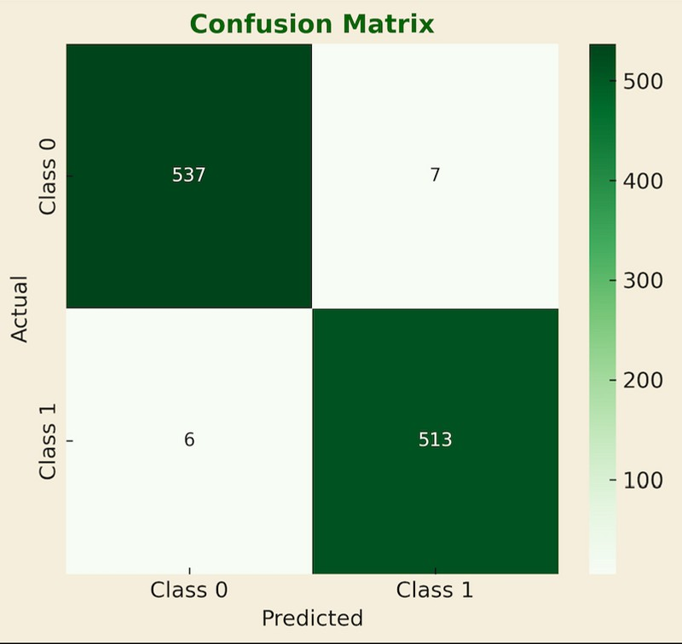
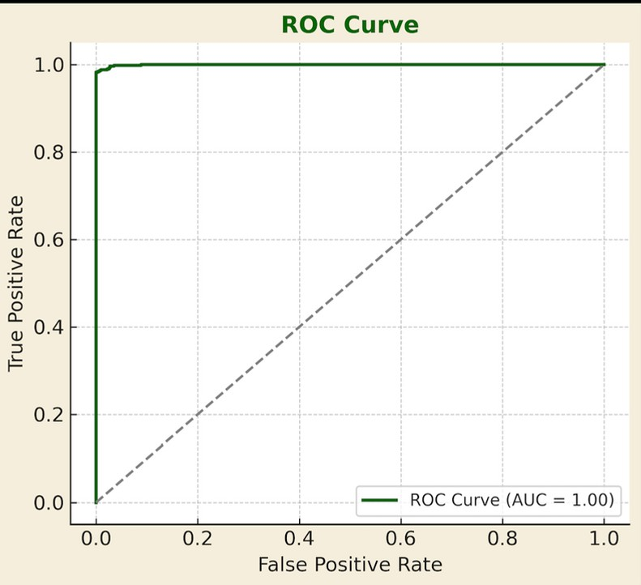
GRAPHICAL REPRESNTATION

Slide 11




LIBRARIES
Programming Language: Python Streamlit: Framework for creating the interactive web app.
FPDF: Library for generating downloadable PDF reports. pandas: For data preparation and handling user inputs.
matplotlib: For optional visualizations. joblib: For loading the pre-trained machine learning model.
transformers: For NLP-based chatbot responses (using pre-trained models). langdetect: For language detection (used in the chatbot).

Slide 12
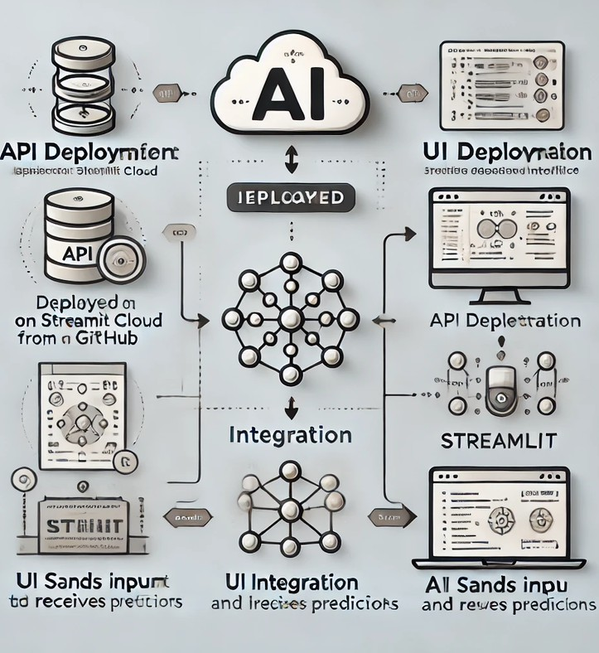
IMPLEMENTATION DEPLOYMENT
API Deployment:
Deployed on Streamlit Cloud, pulling from GitHub
Build command installs dependencies
Start command runs the ML API
UI Deployment:
Deployed on Streamlit, linked to the same repository
Build command installs dependencies
Start command runs the Streamlit app
Integration:
UI sends input to the API, which processes data and returns predictions
Testing:
Both API and UI tested via URLs to ensure proper functionality and smooth integration

Slide 13
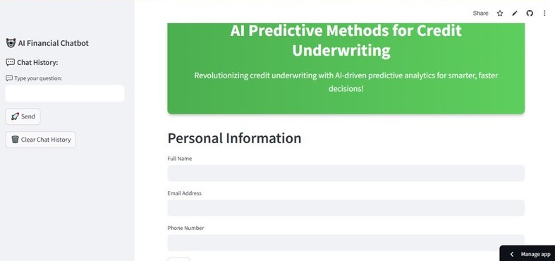
USER INTERFACE

Slide 14
FEATURES OF UI
User-Friendly Interface – Simple and intuitive design for easy navigation.
Loan Application Input – Users can enter relevant financial details for credit evaluation.
AI-Powered Predictions – Displays instant loan approval/rejection based on the trained model.
Real-Time Analysis – Uses machine learning to assess creditworthiness dynamically.
Accessible from Anywhere – Hosted on Streamlit, making it cloud- based and easily accessible.

Slide 15
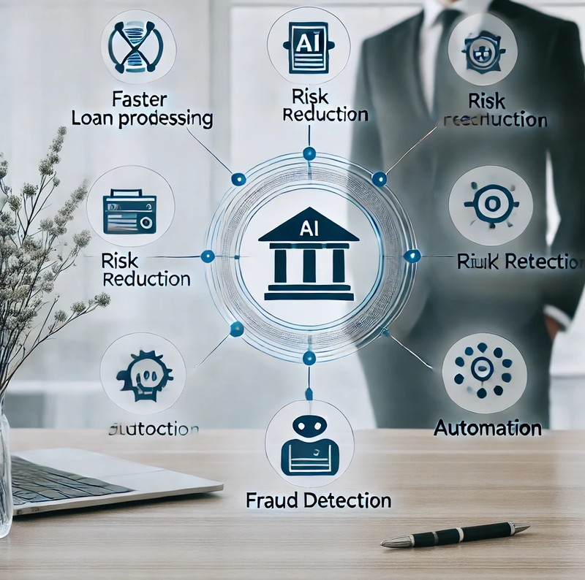
BENEFITS OF MODEL
🚀 Faster Loan Processing
📊 Data-Driven Decision Making
💰 Reduced Risk of Loan Defaults
🎯 High Accuracy in Predictions
📉 Lower Operational Costs
👥 Fair & Transparent Credit Scoring
📈 Continuous Improvement
🔗 Easy Integration with Existing Systems
🌍 Scalable and Adaptable

Slide 16

CHALLENGES IN TRADITIONAL CREDIT UNDERWRITING
⏳ Time-Consuming Process
👥 Human Bias & Subjectivity
📄 Limited Data Utilization
💸 High Operational Costs
⚠ Higher Risk of Loan Defaults
📈 Low Scalability
📊 Inability to Adapt to Market Trends
📉 Inconsistent Decision-Making
🔗 Lack of Integration with Modern Technologies

Slide 17
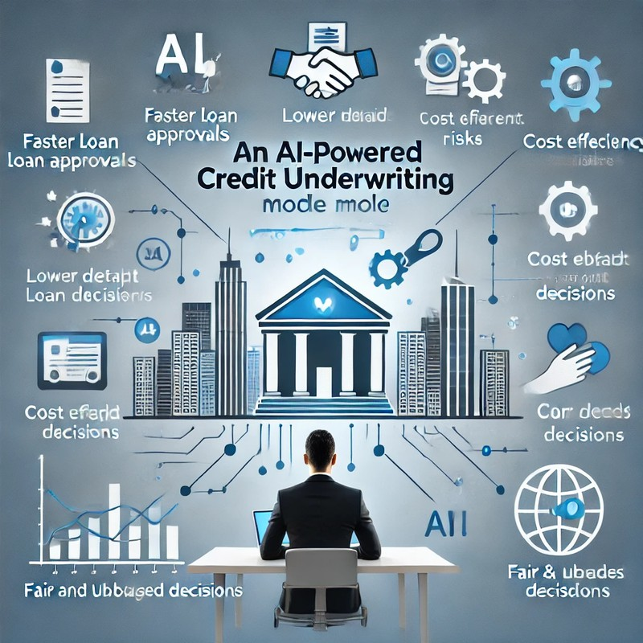
BUSINESS PROPOSITION
Our AI-powered credit underwriting model offers a fast, accurate, and data- driven approach to loan approvals, helping financial institutions minimize risk, reduce costs, and enhance decision- making.
Key Value Propositions:- Faster Loan Approvals Lower Default Risks Cost Efficiency
Fair & Unbiased Decisions Scalability & Adaptability

Slide 18
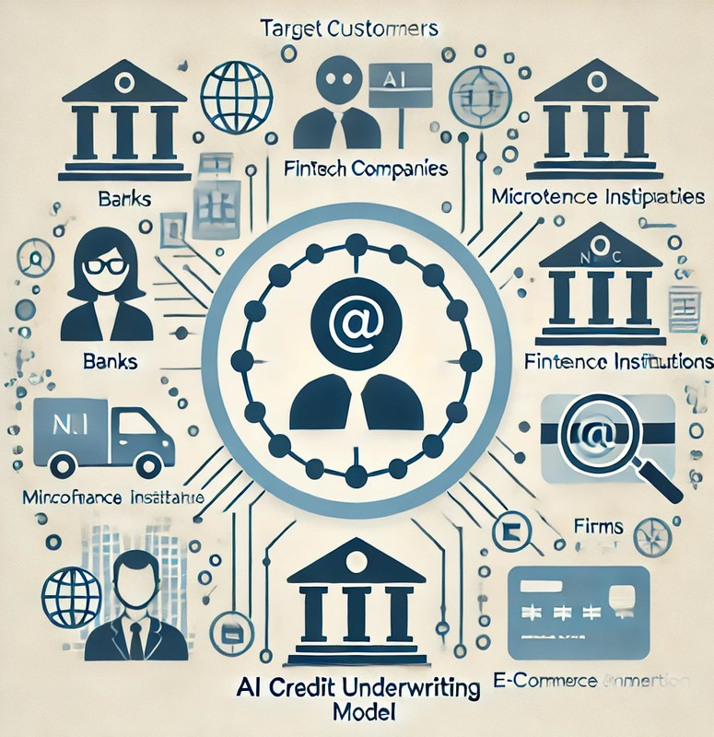
TARGET CUSTOMERS
Banks & Financial Institutions NBFCs (Non-Banking Financial Companies)
Fintech Companies Microfinance & Lending Startups
E-commerce & BNPL (Buy Now, Pay Later) Services
Insurance & Investment Firms

Slide 19

FUTURE SCOPE
I n t e g r a t i o n
s e c u r i t y a n d d a t a i n t e g r i t y .
o f b l o c k c h a i n f o r e n h a n c e d
1
U s e o f a d v a n c e d d e e p l e a r n i n g m o d e l s f o r
2
e v e n m o r e a c c u r a t e p r e d i c t i o n s .
E x p a n d i n g t o g l o b a l f i n a n c i a l m a r k e t s r e g i o n - s p e c i f i c r i s k a s s e s s m e n t s .
w i t h
3
4
R e a l - T i m e C r e d i t S c o r i n g S y s t e m .
5
C o n t i n u o u s
M o d e l
O p t i m i z a t i o n

Slide 20
CONCLUSION
After evaluating multiple machine learning models for credit underwriting, we observed significant variations in accuracy. The Decision Tree, Random Forest, and XGBoost models outperformed others, achieving over 99% accuracy. This indicates their robustness in predicting credit risk. Logistic Regression showed subpar results, highlighting its unsuitability for this use case due to complex data patterns. The Streamlit framework was employed to deploy the final solution, ensuring an interactive and user-friendly interface for real-world applications.

Slide 21



We sincerely thank Mr. Vivek Gautam sir for his invaluable
guidance and support throughout this internship. His constructive
feedback was instrumental in the successful completion of our
project.
We also extend our gratitude to
Infosys Springboard for providing this amazing
opportunity to apply our
academic knowledge to real- world challenges.
Acknowledgement
This internship allowed us to gain hands-on experience in machine
learning, data preprocessing, model deployment, and UI
development, contributing
significantly to our professional and personal growth.

Slide 22
REFERENCES
1. Books:
Hands-On TensorFlow by Aurélien Géron
Machine Learning with Scikit-Learn, Keras, and
Online Resources:
Scikit-learn Documentation: scikit-learn.org Pandas Documentation: pandas.pydata.org Kaggle: kaggle.com
Articles:
"A Comprehensive Guide to Regression in Machine Learning"
Streamlit Documentation: https://streamlit.io

Slide 23
THANK YOU!

